Slide 1



Hr Employee Attrition
View in Power BI
Last data refresh:
5/18/2026 12:56:02 PM UTC
Downloaded at:
5/18/2026 3:41:20 PM UTC

Slide 2
Overview
Shows workforce composition, attrition patterns, compensation distribution, and engagement indicators to identify drivers of employee turnover and highlight high-risk segments. It surfaces key KPIs, compares attrition across roles and departments, examines overtime and travel effects, and profiles tenure and age cohorts to guide targeted retention actions.

Slide 3
Task Performed
I downloaded the dataset and uploaded the data using the "Get Data" option in Power BI. Then, I utilized the "Transform" option to check for any null values in the dataset.
Deleting redundant columns.
Renaming the columns.
Dropping duplicates.
Cleaning individual columns.
Remove the NaN values from the dataset

Slide 4
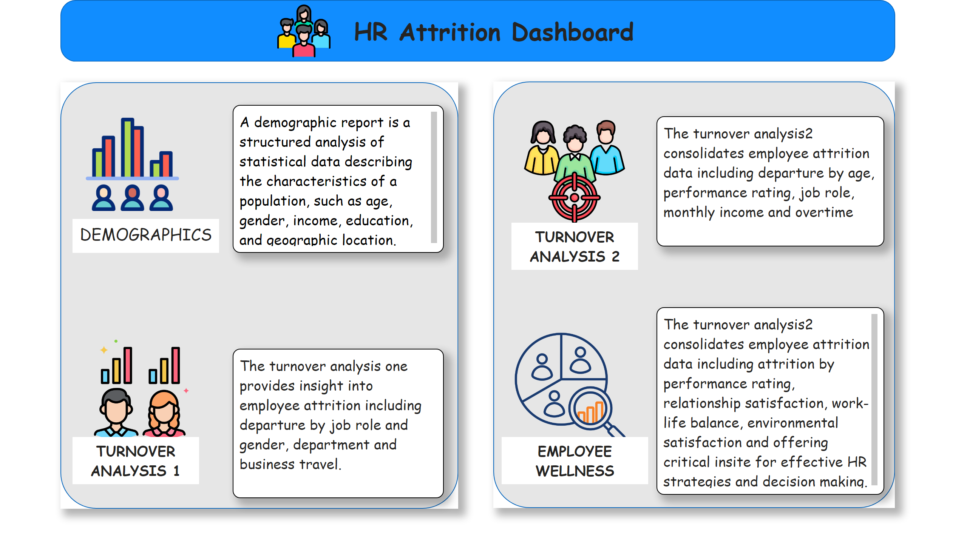
Overview
Notes:
textbox
No alt text provided
textbox
No alt text provided
image
No alt text provided
image
No alt text provided
shape
No alt text provided
textbox
No alt text provided
textbox
No alt text provided
image
No alt text provided
image
No alt text provided
shape
No alt text provided
shape
No alt text provided
textbox
No alt text provided
textbox
No alt text provided
textbox
No alt text provided
textbox
No alt text provided
textbox
No alt text provided
image
No alt text provided

Slide 5
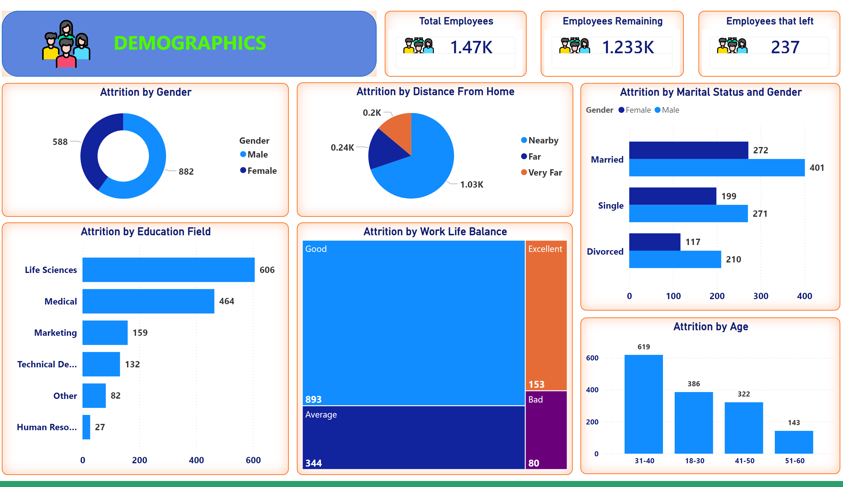
Demographics
Notes:
Total Employees
No alt text provided
Attrition by Gender
No alt text provided
Attrition by Education Field
No alt text provided
Attrition by Age
No alt text provided
Attrition by Work Life Balance
No alt text provided
Attrition by Distance From Home
No alt text provided
Attrition by Marital Status and Gender
No alt text provided
Employees Remaining
No alt text provided
Employees that left
No alt text provided
shape
No alt text provided
textbox
No alt text provided
image
No alt text provided

Slide 6
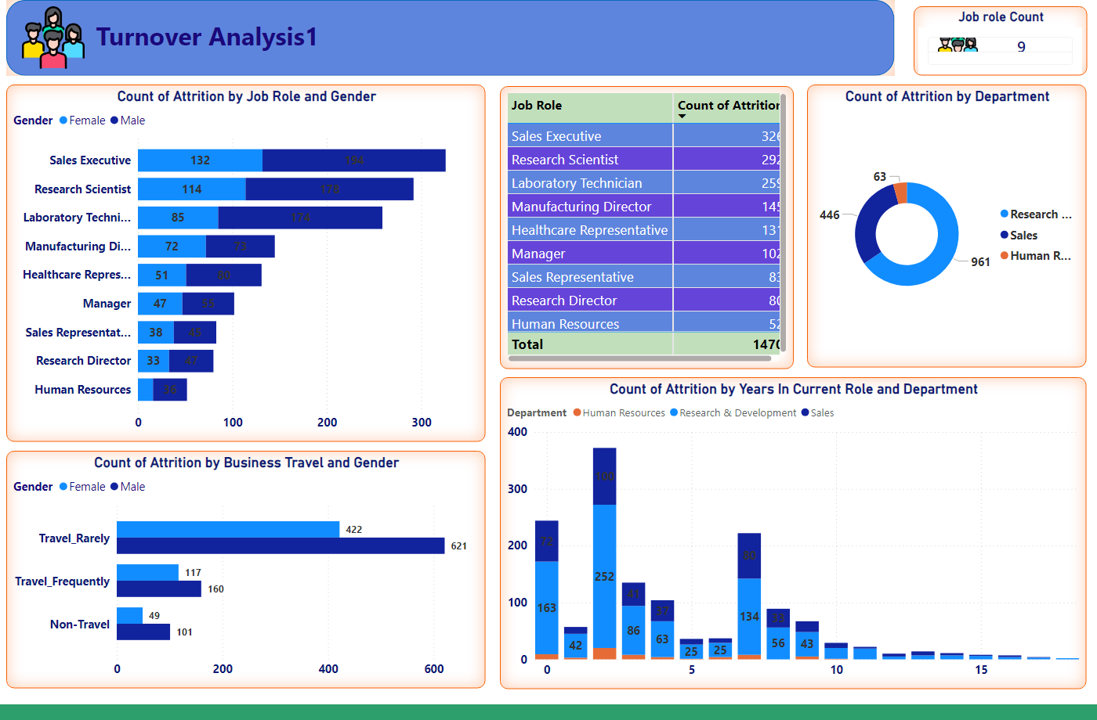
Turnover analysis1
Notes:
Job role Count
No alt text provided
shape
No alt text provided
textbox
No alt text provided
image
No alt text provided
barChart
No alt text provided
donutChart
No alt text provided
columnChart
No alt text provided
clusteredBarChart
No alt text provided
tableEx
No alt text provided

Slide 7
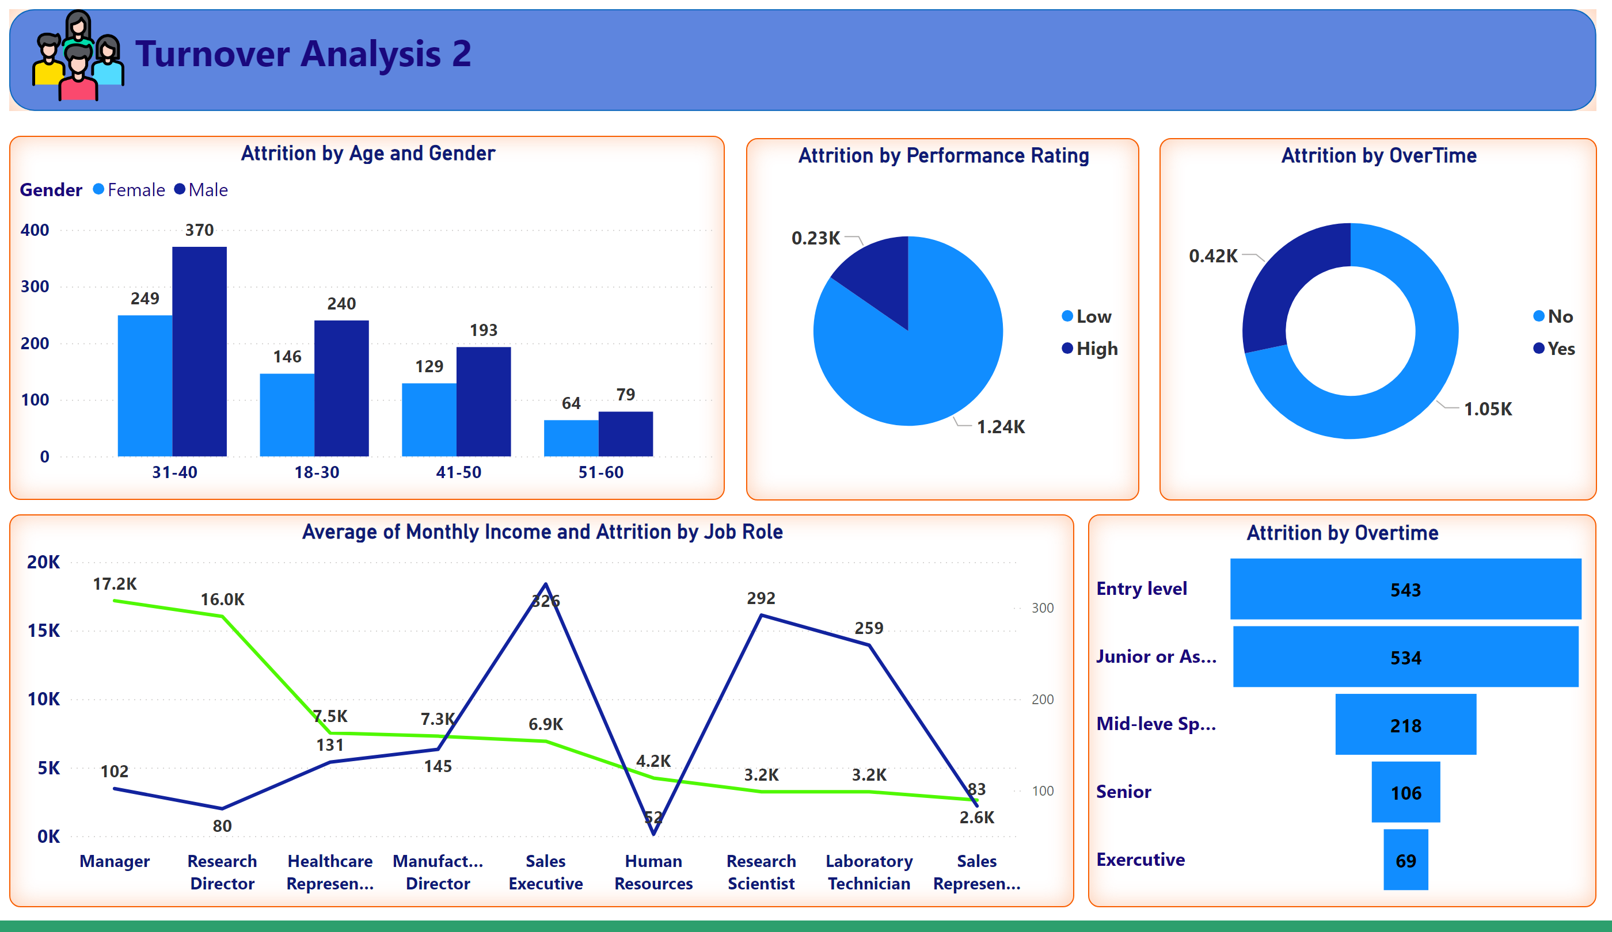
Turnover analysis2
Notes:
shape
No alt text provided
textbox
No alt text provided
image
No alt text provided
Attrition by Age and Gender
No alt text provided
Attrition by OverTime
No alt text provided
Attrition by Performance Rating
No alt text provided
Attrition by Overtime
No alt text provided
Average of Monthly Income and Attrition by Job Role
No alt text provided

Slide 8
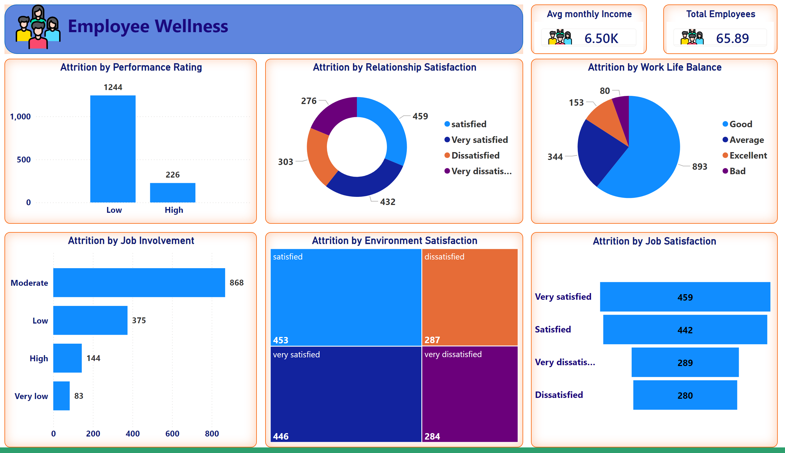
Employee Wellness
Notes:
shape
No alt text provided
textbox
No alt text provided
image
No alt text provided
Attrition by Job Involvement
No alt text provided
Attrition by Relationship Satisfaction
No alt text provided
Attrition by Work Life Balance
No alt text provided
Attrition by Performance Rating
No alt text provided
Attrition by Job Satisfaction
No alt text provided
Attrition by Environment Satisfaction
No alt text provided
Avg monthly Income
No alt text provided
Total Employees
No alt text provided

Slide 9
Overall Insight
Sales Representatives are the single biggest attrition problem: ~40% attrition rate from a headcount of 83, far above other roles.
Laboratory Technicians (24% attrition) and Human Resources (23% attrition) are additional high-risk roles with material headcounts.
Senior and leadership roles (Manager, Research Director, Manufacturing Director) show very low attrition (≈2.5–6.9%), indicating turnover is concentrated in frontline/technical roles

Slide 10
Overall Insight
Attrition is heavily front-loaded: employees in the first year (tenure 0–1 years) experience the highest attrition (≈34–36%), pointing to new-hire retention as a major issue.
After year 1, attrition drops sharply and stabilizes in mid-tenure (2–10 years) at much lower rates (~12–18%), so most turnover risk is early in tenure.
Long-tenure employees (11+ years) have the lowest attrition (≈6.5–16%), suggesting retention improves substantially with tenure.

Slide 11
Overall Insight
There is a pronounced anomalous spike in attrition around tenure year ~31 (attrition ~50%), likely a data or cohort anomaly that requires investigation.
By age, most leavers are concentrated in the 31–40 band so mid-career employees are the largest source of exits.
Younger (18–30) and older (41+) age groups contribute far fewer leavers in absolute terms, implying retention interventions should prioritize late-20s to late-30s employees.

